Slide 1
The APLA Language
Anuj Thula, Param Mehta, Luis Quintanilla, Sai Aditya Bodavala
Team 31,
SER 502,
Arizona State University

Slide 2
Features
Here are some of the Features we implemented in our language:
Datatypes: Integer
Decisions: If- then - else.
Operators:
Assignment: =
Arithmetic: +, -, *, /
Logical: and, or
Console write: “println”.

Slide 3
Interpreter Used
We have used the “ANTLR” interpreter in our language.
In computer-based language recognition, ANTLR (pronounced Antler), or Another Tool For Language Recognition, is a parser generator that uses LL(*) for parsing. ANTLR is a robust framework that has been developed for over 25 years and is used in various proven technologies such as Hadoop, Hive etc.(https://en.wikipedia.org/wiki/ANTLR)
ANTLR is the successor to the Purdue Compiler Construction Tool Set (PCCTS), first developed in 1989, and is under active development. Its maintainer is Professor Terence Parr of the University of San Francisco.
We will go into detail on the installation and use of this interpreter further. [1]
Terminal code to compile your grammar using antlr:
Java –jar ../lib/antlr.jar –package de.letsbuildacompiler.parser –o ../src/de/letsbuildacompiler/parser –no-listener –visitor Demo.g4

Slide 4
Design
Datatypes
Support for integers
Keywords support for int, If - then - else, println.
Decision
If - then - else support.
Also support for if.
Exception Handling
Integer exception handling.
Variable, String exception handling.
Method
User can also use methods in the program.
File Input and Assignment:
The user input can also be accepted using a .apla file.

Slide 5
Run-Time
So for our language we have implemented a bottom-up parsing technique design which is shown by the diagram below:
Bottom-up parsing starts from the leaf nodes of a tree and works in upward direction till it reaches the root node. Here, we start from a sentence and then apply production rules in reverse manner in order to reach the start symbol. The image given below depicts the bottom-up parsers available.
The input would be a parse tree.
Terminal code to generate Parse Tree:
java –cp bin:lib/antlr.jar org.antlr.v4.runtime.misc.TestRig de.letsbuildacompiler.parser.Demo program -ps /tmp/baum.ps ../Compiler/code.demo
okular /tmp/baum.ps (make sure you install okular)

Slide 6
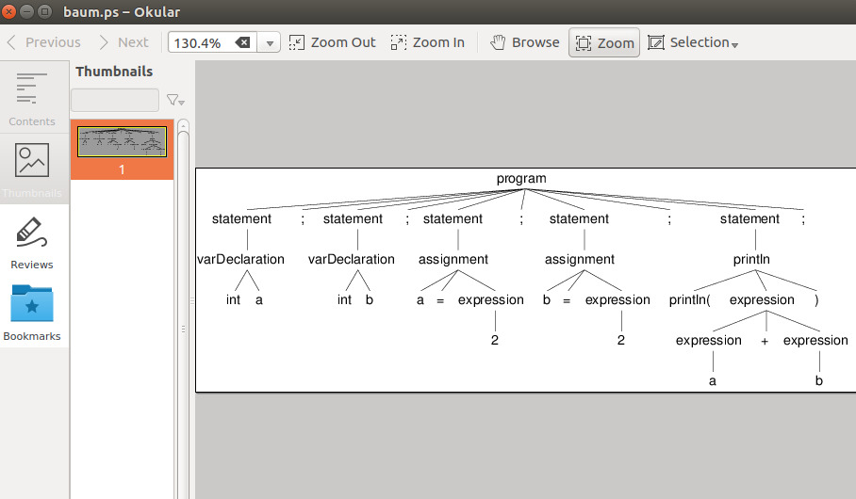
ANTLR Generated Parse Tree

Slide 7
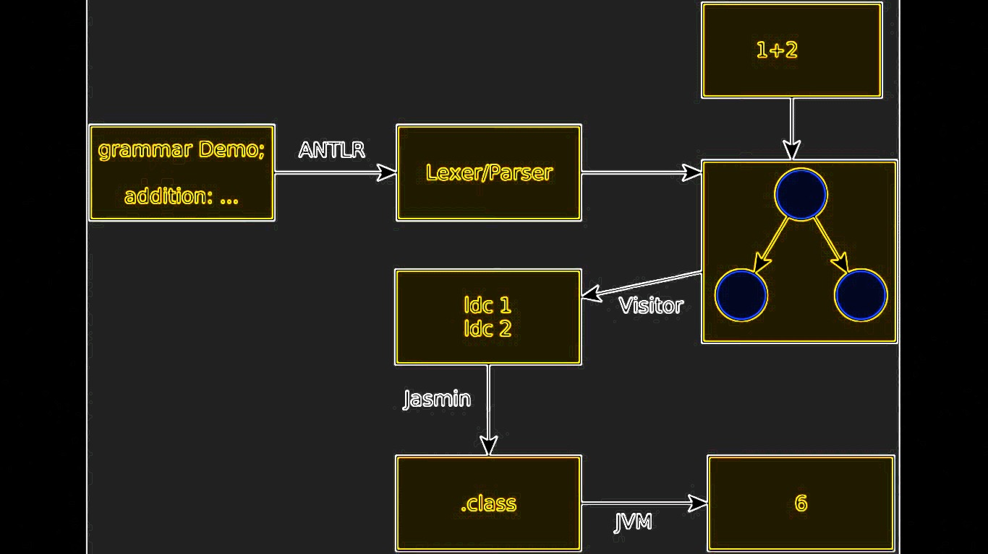
Design Diagram

Slide 8
Grammar The Grammar we used is in the EBNF(Extended Backus–Naur form) so it can be implemented with Antlr to generate our parse
program
: programPiece+ ;
programPiece
: statement #StatementPiece
| method #MethodPiece
;
statement
: println ';'
| varAssignment ';'
| assignment ';'
| branch
;
branch
: 'if' '(' condition=expression ')' True=section 'else' False=section ;
section
: '{' statement* '}' ;
expression
: left=expression operator=('*' | '/') right=expression #MULTDIV
| left=expression operator=('+' | '-') right=expression #PLUSMINUS
| num=NUM #Number
| varName=NAME #Variable
| methodCall #MethodExp
;
assignment: varName=NAME '=' expr=expression ;

Slide 9
Grammar
varAssignment
: 'int' varName=NAME;
println
: 'println(' argument=expression ')' ;
while_statement
: 'WHILE' expression_condition '{' block '}'
method
: 'int' methName=NAME '(' ')' '{' statements=statementList 'return' returnVal=expression ';' '}' ;
statementList: statement* ;
methodCall
: methName=NAME '(' ')' ;
NAME
: [a-zA-Z][a-zA-Z0-9]*;
NUM
: [0-9]+;
WHITESPACE
: [ \t\n\r]+ -> skip;

Slide 10
Lexical Analyzer
The Lexical analyzer we used is called ANTLR.
. ANTLR (code):
ANTLR reads grammar file to parse input
Generates a list of .java files that enable access to the elements of input (similar to a parse tree)
.Tokens
Every unique character tokenized and added to the “stack”
.Lexer
Uses the tokens with the generated set of rules that were defined
.Parser
Parses the code using the lexer and tokens as rules and generates methods based on the tokens and variables
.Visitor (interface)
Overridable functions are made here. These can be later overridden in MyVisitor.Java
.BaseVisitor

Slide 11
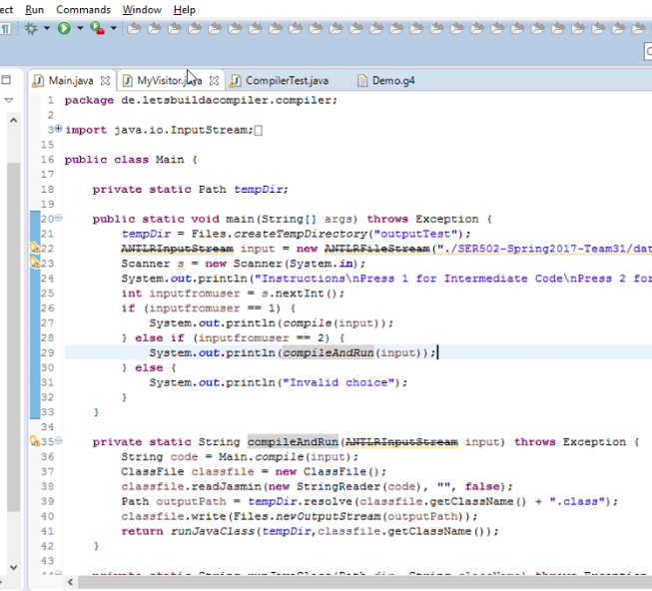
Intermediate Code:
We used Java to get our intermediate code:
In Main.java,
‘Compile’ is used to get the Intermediate code.
‘Compile and Run’ is used to get output code.

Slide 12
Intermediate Code Example:
class public HelloWorld
.super java/lang/Object
.method public static main([Ljava/lang/String;)V
.limit stack 100
.limit locals 100
ldc 4
istore 0
ldc 16
istore 1
iload 0
iload 1
iload 1
imul
iload 0
idiv
iadd
iload 1
isub
istore 2
getstatic java/lang/System/out Ljava/io/PrintStream;
iload 2
invokevirtual java/io/PrintStream/println(I)V
return
.end method

Slide 13
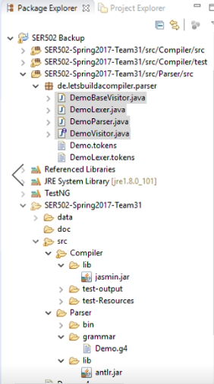
We used jasmin to make class files for our intermediate code.
Jasmin is an assembler for the java virtual machine. It takes ASCII descriptions of java classes, written in a simple assembler-like syntax using the java virtual machine instruction set. It converts them into binary java class files, suitable for loading by a java runtime system.
It is contained in src/compiler/lib/jasmin.Jar [2]

Slide 14
References:
[1] ANTLR: http://www.antlr.org/
[2] Jasmin: http://jasmin.sourceforge.net/
Both tools were taken from these sources and installed to Eclipse accordingly.
Eclipse: https://eclipse.org/

